Slide 1

Personal Loan Prediction
Team Members :
* P Sri Ram Ganesh
* M Srinivas
* Y Satya Sai

Slide 2
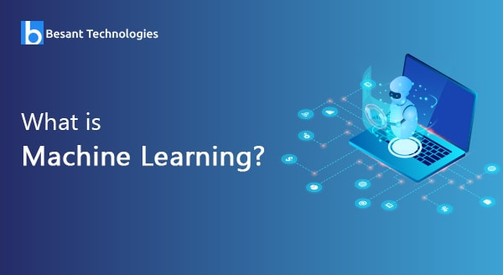

Slide 3
Machine Learning
Machine learning is an application of artificial intelligence (AI) that provides systems the ability to automatically learn and improve from experience without being explicitly programmed. Machine learning focuses on the development of computer programs that can access data and use it learn for themselves.

Slide 4
Personal loan prediction
The training data set is supplied to machine learning model, on the basis of this data set the model is trained. Every new applicant details filled at the time of application form acts as a test data set. After the operation of testing, model predict whether the new applicant is a fit case for approval of the loan or not based upon the inference it conclude on the basis of the training data sets.

Slide 5
Loan Prediction Methodology

Slide 6
Random forest classifier
Random Forest Classifier Is ensemble algorithm. Ensembled algorithms are those which combines more than one algorithms of same or different kind for classifying objects.
Random forest classifier creates a set of decision trees from randomly selected subset of training set. It then aggregates the votes from different decision trees to decide the final class of the test object.

Slide 7
code
from sklearn.ensemble import RandomForestClassifier model=RandomForestClassifier(n-estimation=10,criteria=‘entropy’,random_state=0)
model.fit(x_train,y_train)
...Thank You...

